Slide 1
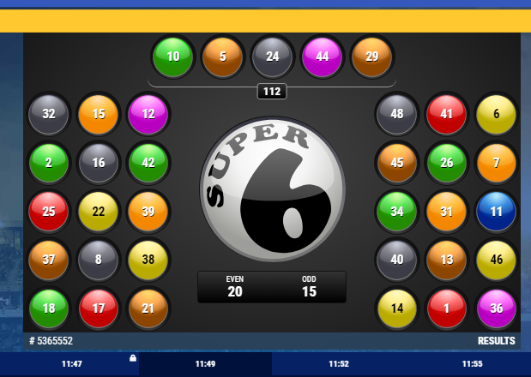
THE SUPER SIX

Slide 2
Launching of Betking Online Account
Go to the browser and type www.betking.com (1)
Enter username and password and click login (2)
1
2

Slide 3
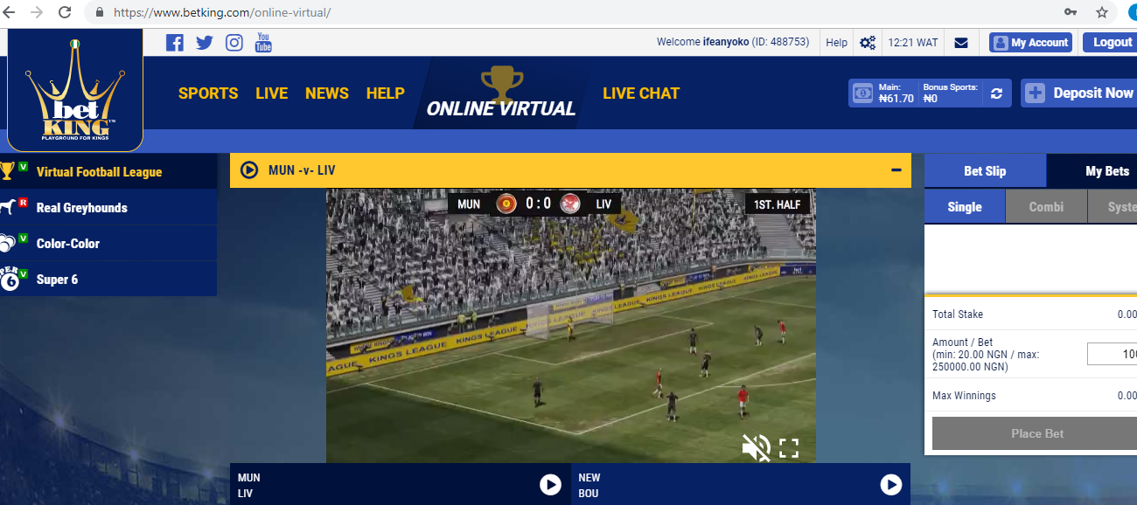
Betking Online Virtual
The online virtual has 4 different virtual game with virtual league as the 1st and the default.
1 – Virtual League
2 – Real Greyhounds
3 – Color-Color
4 – Super 6
1
2
3
4

Slide 4
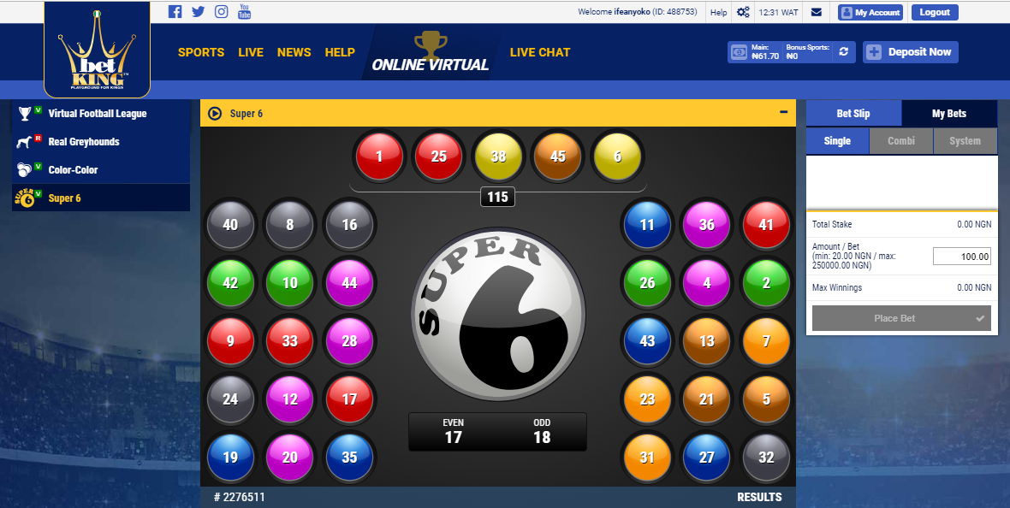
Launching of Super 6
Click on Super 6 option to launch.
1 – The first 5 balls
2 – The sum of the first 5 balls
3 – Number of even and odd numbered balls
Collection of all 35 balls
1
2
4
3

Slide 5
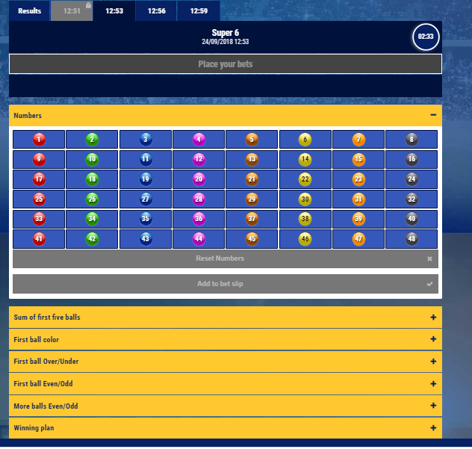
Super 6 Market Options
1 – This shows the tab for result of past game and the tab for time of current and future games
2 – Numbers is a market option that allows punters to select possible numbers to come
3 – This shows other market options which include: sum of first five balls; first ball color; first ball over/under; first ball even/odd; and more balls even/odd.
1
2
3

Slide 6
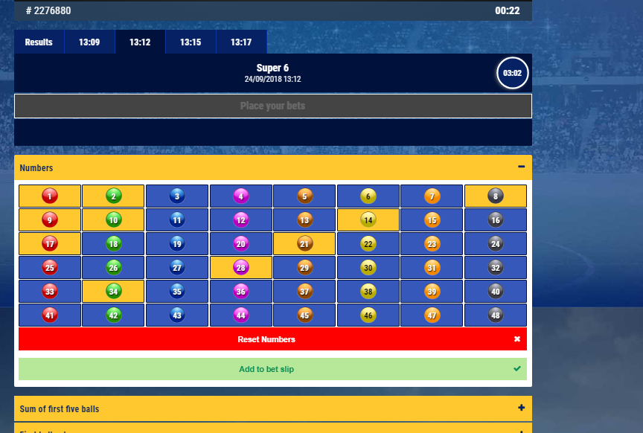
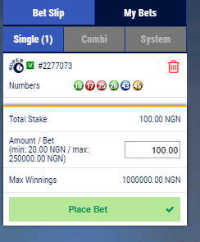
Numbers to come
Market options: Number
To predict numbers to come, select between 6 and 10 different numbers and click on add to bet slip
Click on Place Bet.

Slide 7
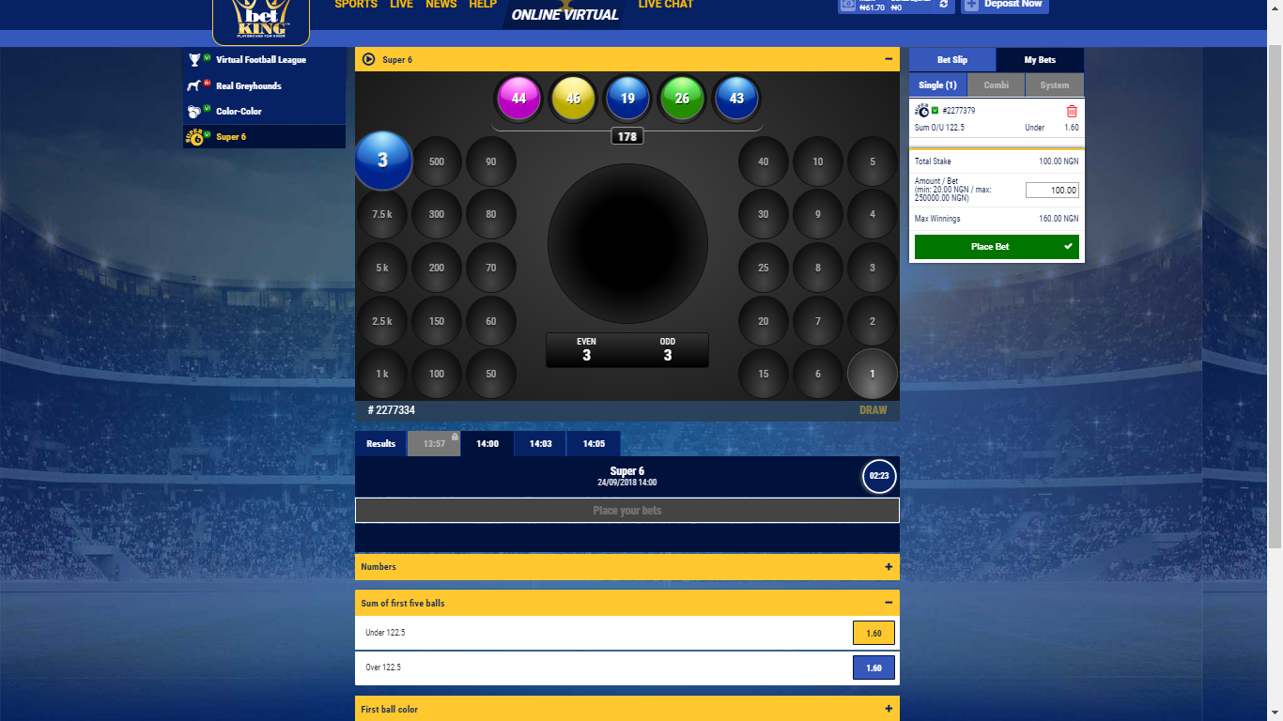
Sum of first five balls
Market options: Under 122.5 and Over 122.5
To predict Under 122.5 for sum of first 5 balls, click on the tab for sum of first 5 balls; click on the odds for Under 122.5 and then click on place bet.
To predict Over 122.5 for sum of first 5 balls, click on the tab for sum of first 5 balls; click on the odds for Over 122.5 and then click on place bet.

Slide 8
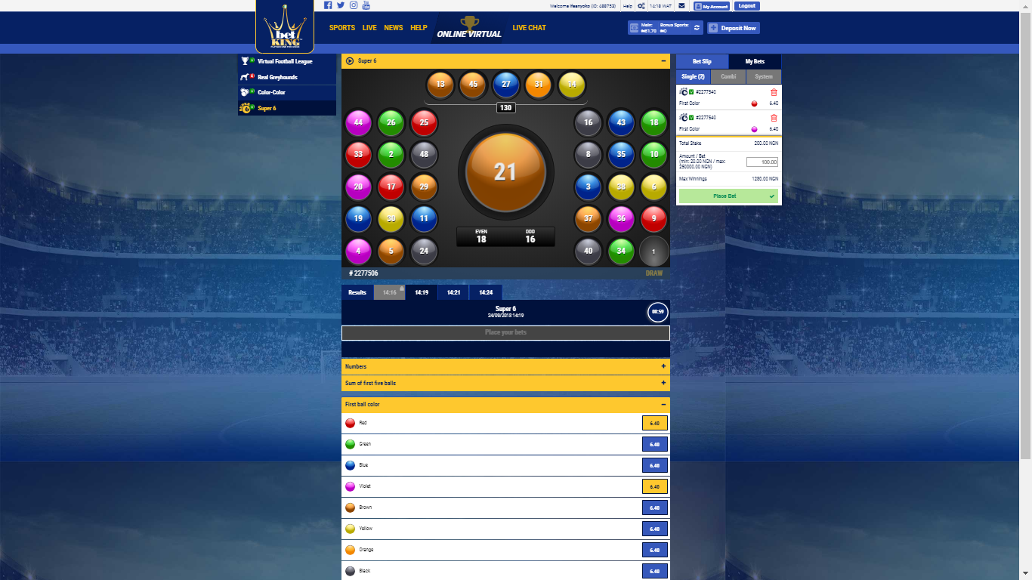
First Ball Color
Market options: Red; Green, Blue; Yellow; Violet, Brown, Orange and Block
To predict first ball red, click on the first ball color tab, click on the odd of red and click on place bet.
To predict first ball violet, click on the first ball color tab, click on the odd of violet and click on place bet.
To predict first ball black, click on the first ball color tab, click on the odd of black and click on place bet.
To predict first ball orange, click on the first ball color tab, click on the odd of orange and click on place bet.

Slide 9
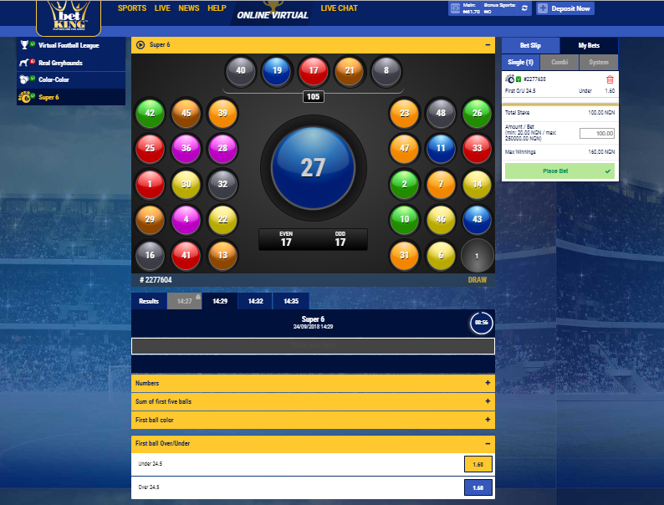
First Ball Over/Under
Market options: Under 24.5 and Over 24.5
To predict first ball under 24.5, click on the first ball Over/Under tab, click on the odd of Under 24.5 and click on place bet.
To predict first ball Over 24.5, click on the first ball Over/Under tab, click on the odd of Over 24.5 and click on place bet.

Slide 10
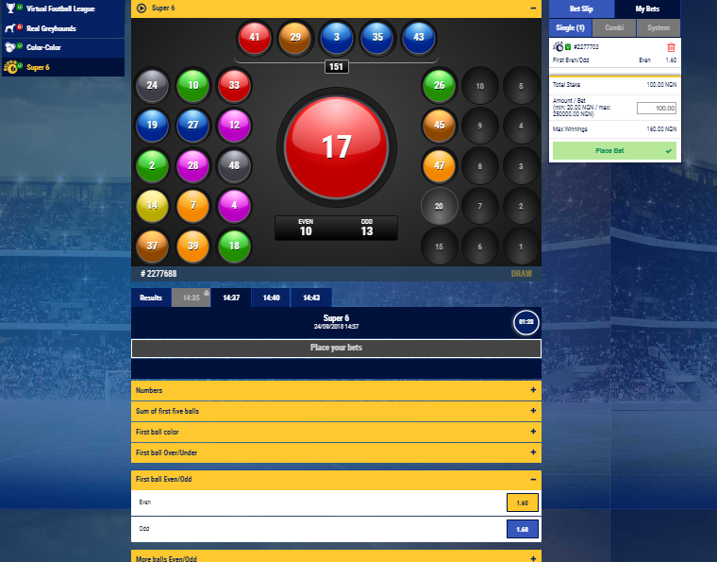
First Ball Even/Odd
Market options: Even and Odd
To predict first ball Even, click on the first ball Even/Odd tab, click on the odds of Even and click on place bet.
To predict first ball Even, click on the first ball Even/Odd tab, click on the odds of Odd and click on place bet.

Slide 11
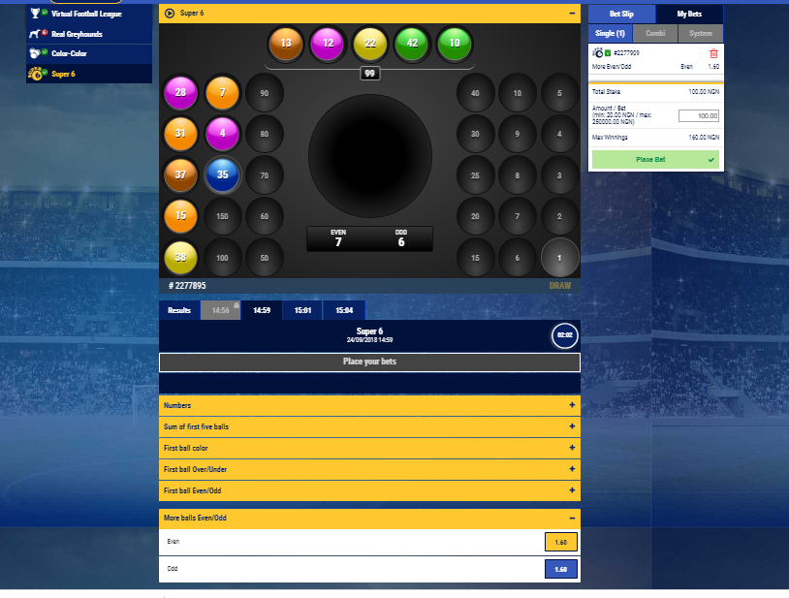
More Balls Even/Odd
Market options: Even and Odd
To predict more balls Even, click on the more balls Even/Odd tab, click on the odds of Even and click on place bet.
To predict more balls Odd, click on the more balls Even/Odd tab, click on the odds of Odd and click on place bet.

Slide 12
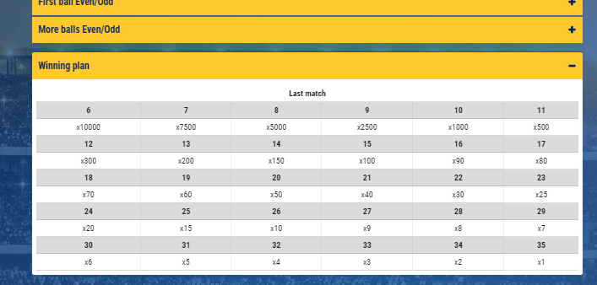
Winning Plan
The winning plan helps punters to calculate their possible winnings based on the selections.
When 6 balls are selected and 5 balls appear, the amount staked is multiplied by 10,000
When 7 balls are selected and 5 balls appear, the amount staked is multiplied by 7,500
When 8 balls are selected and 5 balls appear, the amount staked is multiplied by 5,000
When 9 balls are selected and 5 balls appear, the amount staked is multiplied by 2,500
When 10 balls are selected and 5 balls appear, the amount staked is multiplied by 1,000

